Slide 1

Explainable AI for Estimating Pathogenicity of Genetic Variants Using Large-Scale Knowledge Graphs
Shuya Abe, Shinichiro Tago , Kazuaki Yokoyama and Masaru Fuji
11.19.24
Final Presentation:
Daniel Gutierrez
CAP5610
Professor Ananda M. Mondal

Slide 2
Overview
Single nucleotide variants(SNV’s) are mutations in the human genome that have the potential to cause autoimmune disorders and diseases like cancer, but could also be benign and have no impact of health
Genomic omics data obtained from Next Generation Sequencing, an efficient form of DNA sequencing, is too vast to be able to analyze manually and difficult to understand without prior domain knowledge
Unfortunately, the lack of explainability in traditional AI methods have served as a bottleneck for Genomic Medicine, since the lack of comprehensible clinical interpretations have led to contemporary clinicians to have distrust in the field
Paper Proposal: xAI system that utilizes a knowledge graph of clinical interpretations to estimate and explain the pathogenicity of a SNV
My Proposal: Using a XGBoost Model trained on raw genomic/proteomic prediction scores for high estimation in distinguishing pathogenicity, with SHAP providing explanation

Slide 3
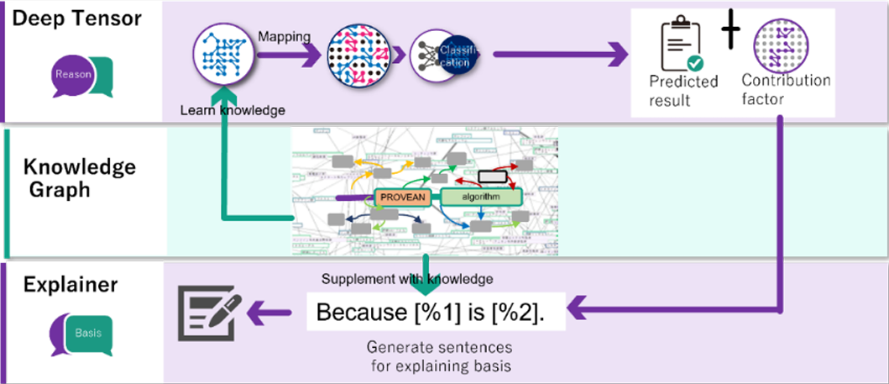
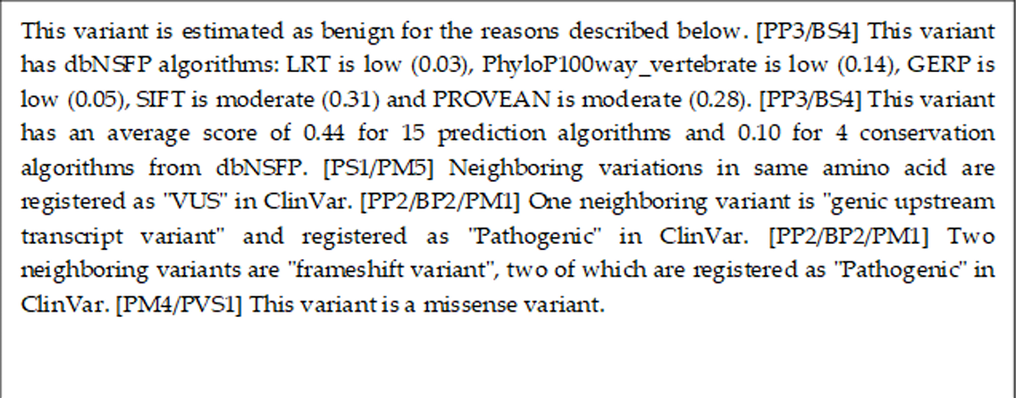
Goals
Implement an XGBoost classification model, trained on the datasets used in the assigned paper, to achieve high estimation metrics
Compare performance metrics with those of obtained from “Deep Tensor” classification model used in the paper as well as other comparison models
Evaluate the the interpretability and usefulness of explanations generated by SHAP and compare to that of the paper’s xAI

Slide 4

Objectives
Obtain access to relevant datasets used in the paper(ClinVar and DbNSFP)
Extract, pre-process, and merge both datasets extensively.
Convert gzip to csv files
Perform Missing values and Outlier Analysis
Address class imbalance(more Pathogenic than Benign samples)
Train XGBoost model
Apply SHAP to the model predictions and observe local/global feature importance to achieve explainability
Compare metrics and explainability to the paper

Slide 5

Motivations
Genomic Medicine has the potential to help solve difficult pathologies as well as serve as early-warning diagnoses for potential diseases that could save lives
Explainable AI in Genomics can increase accuracy in estimating pathogenicity while allowing for interpretability and transparency to relevant stakeholders like non-technical clinicians and patients
The results of the assigned paper and this project will serves as a contribution to the growing usage of bleeding edge xAI in the medical field to interpret complex omics data and drive informed decision making by health professionals

Slide 6
Prior Art and Challenges
Method: Deep Tensor
Accuracy: 0.94
Precision: 0.94
Recall: 0.94
F1-Score: 0.94
AUC: 0.98
Shortcomings
Deep Tensor is a proprietary classification model owned by Fujitsu not open to the public. Knowledge Graph and processed datasets are also not open-source
Significant computational overhead
Limited Feature Set
Application of Knowledge Graph in real life
Challenges
Learn how to preprocess both ClinVar and DbNSFP dataset without experience, considering relative “messiness” of the raw data
Closely monitor utilization of hardware resources during extraction and pre-processing given the substantial size and dimensionality of the DbNSFP dataset
Address Feature Selection without domain knowledge
Interpret SHAP findings

Slide 7
Data Sources and Description
ClinVar
Summarized Genomic data that includes clinical phenotypes, interpretations, and descriptions for SNV’s
Data Matrix Size: 6149023 rows x 40 columns
Categorical feature “Clinical Significance” will be utilized in the merged dataset to serve as the class label
Index Features kept to link Clinvar to DbNSFP
PositionVCF, ReferenceAlleleVCF, AlternativeAlleleVCF, Chromosome
Samples missing Clinical Significance and PositionVCF values were filtered
Remaining features dropped
Cleaned data matrix size: 6149022 rows x 8 columns
DbNSFP
Database that compiles functional predictions and annotations for SNV’s from various algorithms, multiple files
Algorithms predicted a behavior that can be attributed to pathogenicity, ie. deletion, protein dysfunction, etc.
Data matrix size: 84013118 rows x 458 columns
Cleaned matrix size: 63592 rows x58 columns
Only Rank-score features kept along with relevant indices for merging
Normalized of raw score using database ranking, usually 0-1
Chr, pos(1-based), ref, alt for linkage

Slide 8
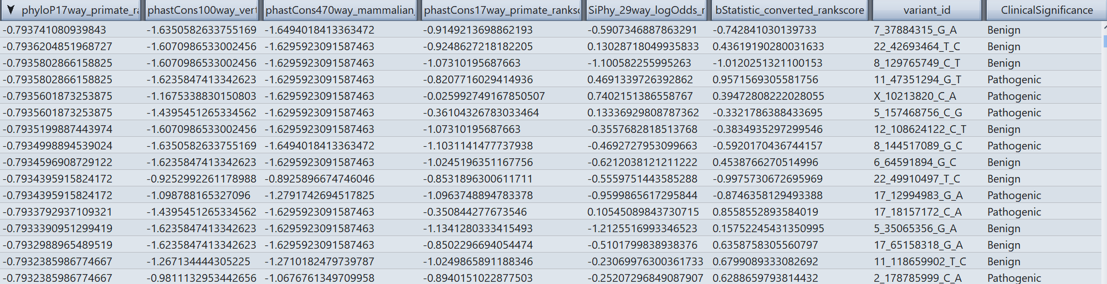
Data Sources and Description

Slide 9
Methods and Tools
Preprocessing
Gzip
Multiple .gz files separated by chromosome number need to be combined and extracted into a single .csv file
Dask
Python library that utilizes parallel processing to perform operations on data frames such as outlier analysis and feature selection
Merging datasets
Sci-kit Learn
KNN Data Imputation
RowZero/CSV Editor Pro
GUI for visualizing data set subsets
Model Training
Pandas
Data Manipulation for random train-test split and data frames
Sci-Kit Learn
Stratified K-Fold CV
Grid Search
Automated tuning by training models on different hyperparameter combinations
Best Model determined by K-Fold CV using training ROC AUC
XGBoost
Gradient Boosted Trees
Addressed Class imbalance using scale_pos_weight

Slide 10
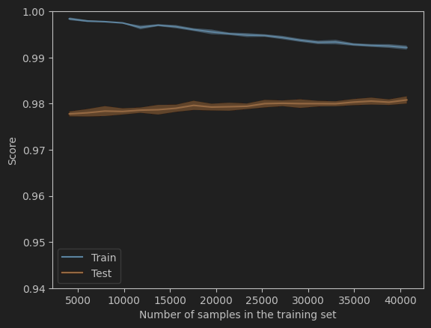
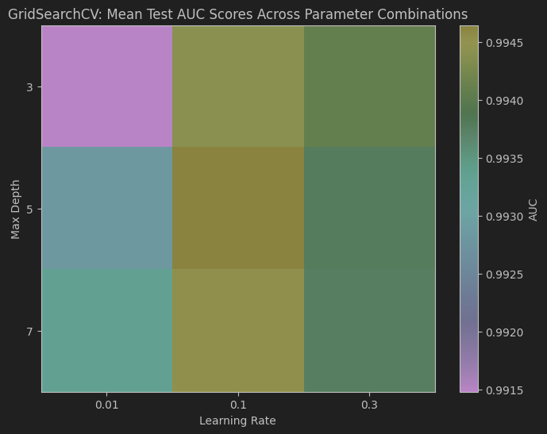
Results
Dataset Distribution:
Pathogenic:50863, Benign: 12729
Best XGBoost Model
Best Parameters: {'colsample_bytree': 0.6, 'learning_rate': 0.1, 'max_depth': 7, 'min_child_weight': 1, 'scale_pos_weight': 0.2502580486606046, 'subsample': 1.0}
Best Average AUC: 0.99
High Test and Validation Scores, low training loss, converges towards the end.
Ensures we are not overfitting and generalizing well across all kfolds
Heat Map shows correlation between a Max Depth of 7 and Learning Rate of 0.1, leading to a high Reciever Operating Characteristic AUC

Slide 11
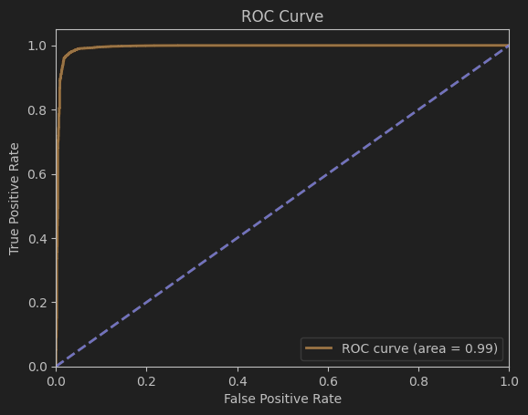
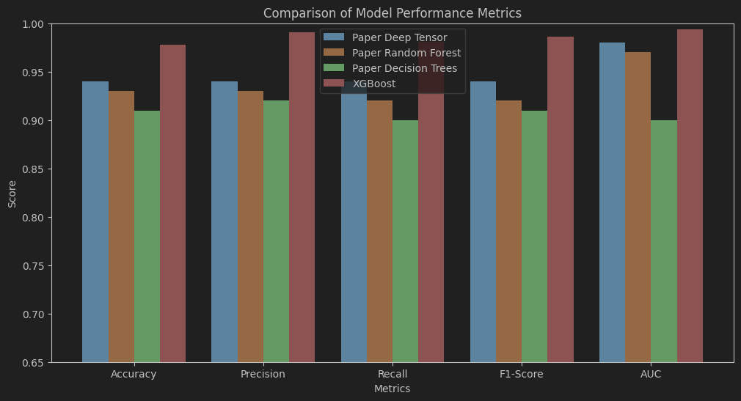
Results
Final Results:
Test Accuracy: 0.98
Test Precision: 0.99
Test Recall: 0.98
Test f1-score: 0.99
Test ROC AUC: 0.99
Confusion Matrix:
[2456 90]
[ 192 9981]
The model exceeded the performances metrics of the deep tensor model as well as those of the comparison models mentioned in the assigned oaoer

Slide 12
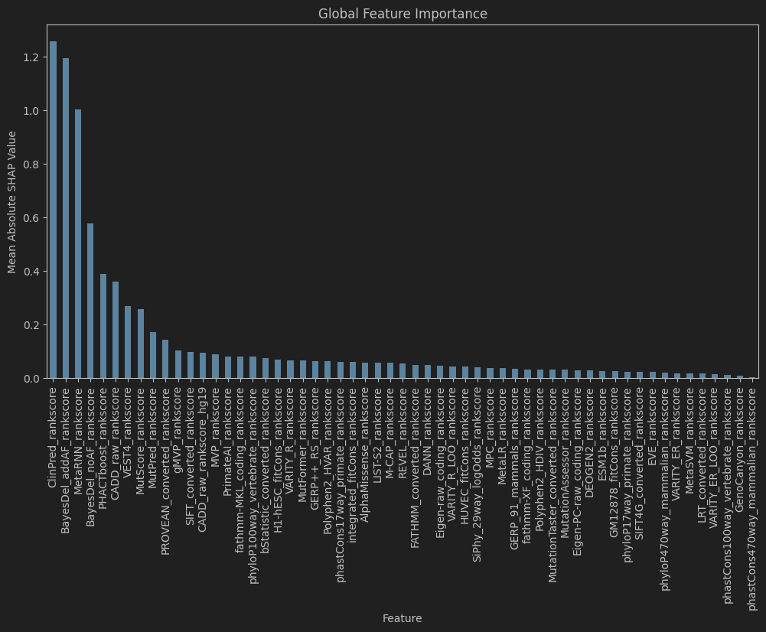
Results: SHAP

Slide 13
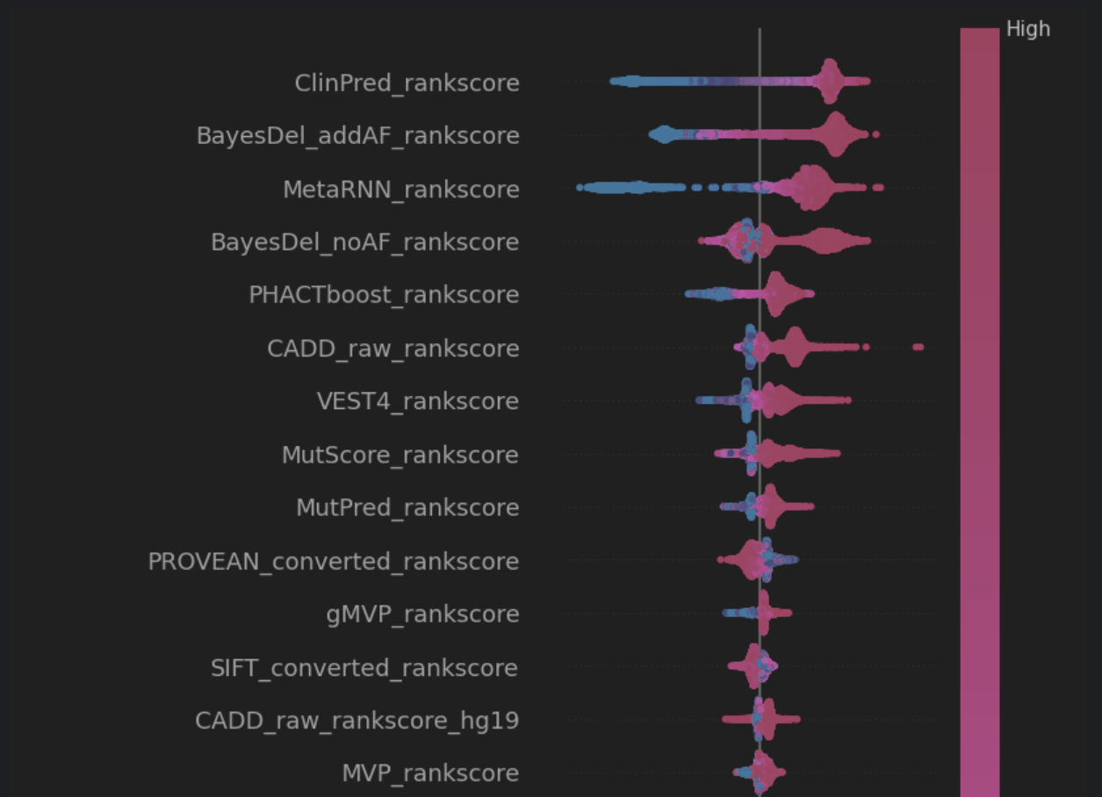
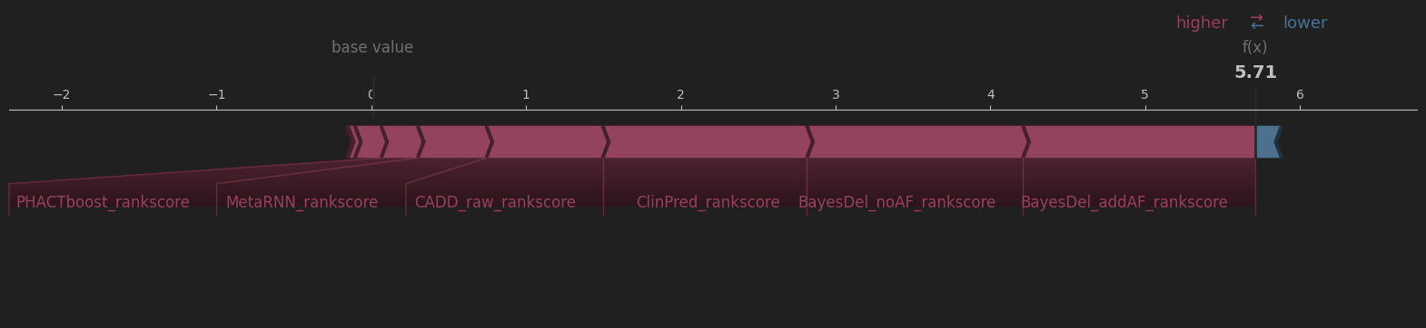
Results: SHAP

Slide 14


Discussion
The high accuracy of the XGBoost model indicated its potential for predicting pathogenicity of genetic variant, especially considering its improvement on the metrics of “Deep Tensor” from the assigned paper
SHAP highlighted the importance of the four features ClinPred, BayesDel, and MetaRNN rankscores in classification, which equally had a hand in classifying pathogenic and benign classes.
Limitations:
Could potentially study the use of raw scores from the same algorithms instead of normalized rankscores
Potentially use OmniXAI, which offers a GPT explainer for SHAP explainations

Slide 15
Contributions & Conclusions
Explainable AI has the potential to revolutionize genomics by providing accurate and interpretable predictions. The analysis and results obtained from this experiment as well as the results from the paper represents a step towards realizing this potential and improving the diagnosis and treatment of genetic diseases
Contributions
Introduction of XGBoost and SHAP as a viable tool for interpreting complex genomic data due to its high accuracy, efficiency, and availability to the public
A deployable model that is capable of assigning pathogenic classifications to variants in the DbNSFP that do not have one from Clinvar and have the relevant feature values from each algorithm

Slide 16
Q/A?

